Slide 1
Probability and Statistics
Dr Bakhtawar
Software Engineering
NUML Islamabad

Slide 2
Probability
Probability can be defined as the chance of an event occurring. Some examples of how probability is used everyday would be weather forecasting, “85% chance of snow”.

Slide 3
Sample Spaces and Probability
A probability experiment is a process that leads to well-defined results called outcomes.
A sample space is the set of all possible outcomes of a probability experiment.
An event consists of outcomes.

Slide 4
Sample Spaces
Experiment
Sample Space
Toss a coin
Head,
Tail
Roll a die
1, 2, 3, 4, 5, 6
Answer a true/false
True, False
question
Toss two coins
HH,
HT, TH, TT

Slide 5
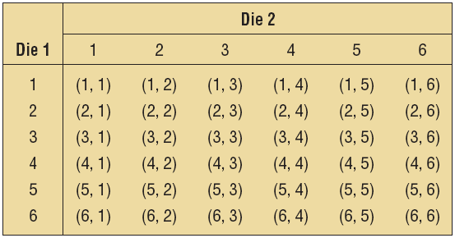
Example : Rolling Dice
Find the sample space for rolling two dice.

Slide 6
If two dice are rolled one time, find the probability of getting these results.
A sum of 6
Doubles
A sum of 7 or 11
A sum greater than 9

Slide 7
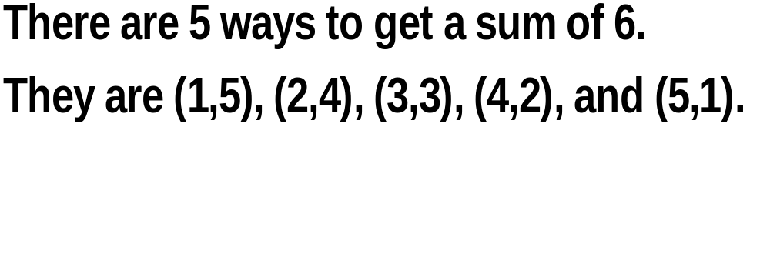

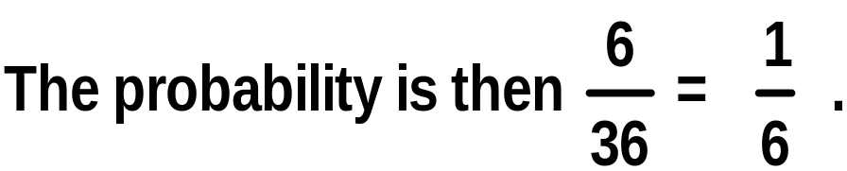
A sum of 6
Total of 36 outcomes
Doubles
There are six ways to get doubles. They are (1,1), (2,2), (3,3), (4,4), (5,5), and (6,6).

Slide 8
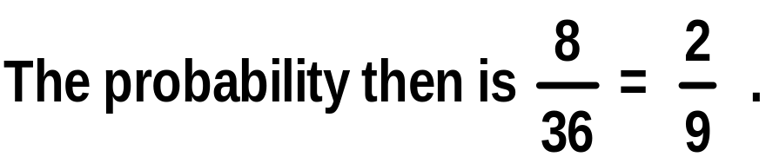

Total of 36 outcomes
A sum of 7 or 11
There are six ways to get a sum of 7. They are (1,6), (2,5), (3,4), (4,3), (5,2), and (6,1).
There are two ways to get a sum of 11. They are (5,6) and (6,5).
A sum of greater than 9
To get a sum greater than nine, one must roll a 10, 11, or 12.
There are six ways to get a 10, 11, or 12. They are (4,6), (5,5), (6,4), (6,5), (5,6), and (6,6).

Slide 9
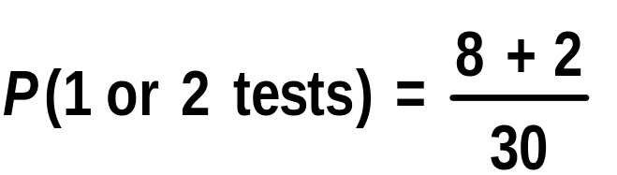
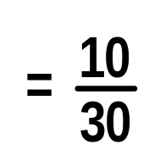
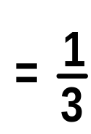
e. The patient has had 1 or 2 tests done.
Number of Tests Performed | Number of Patients
0 | 12
1 | 8
2 | 2
3 | 3
4 or more | 5

Slide 10
Example : Gender of Children
Find the sample space for the gender of the children if a family has three children. Use B for boy and G for girl.
BBB BBG BGB BGG GBB GBG GGB GGG

Slide 11
Example : Gender of Children
Use a tree diagram to find the sample space for the gender of three children in a family.
B
BBB
BBG
BGB
BGG
GBB
GBG
GGB
GGG
B
G
B
B
G
G
B
B
G
G
B
G
G

Slide 12
Example: Gender of Children
If a family has three children, find the probability that two of the three children are girls.
Sample Space:
BBB BBG BGB BGG GBB GBG GGB GGG
Three outcomes (BGG, GBG, GGB) have two girls.
The probability of having two of three children being girls is 3/8.

Slide 13
4.1
Sample Spaces and Probability
Probability Rule 1
The probability of any event E is a number (either a fraction or decimal) between and including 0 and 1.
This is denoted by 0 ≤ P(E) ≤ 1.

Slide 14
4.1
Sample Spaces and Probability
Probability Rule 2
If an event E cannot occur (i.e., the event contains no members in the sample space), its probability is 0.

Slide 15

Exercise 4-9: Rolling a Die
When a single die is rolled, what is the probability of getting a number less than 7?
Since all outcomes—1, 2, 3, 4, 5, and 6—are less than 7, the probability is
The event of getting a number less than 7 is certain.

Slide 16
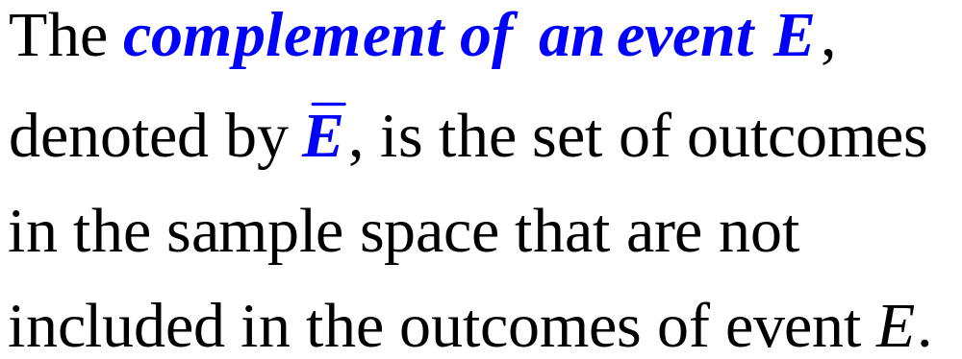

Sample Spaces and Probability

Slide 17
Example : Finding Complements
Find the complement of each event.
Event
Complement
of the Event
Rolling a die and getting a 4
Getting a 1, 2, 3, 5, or 6
Selecting a month and getting a
Getting February, March, April,
May, August, September,
month that begins with a J
October,
November, or
December
getting a weekday
Getting Saturday or Sunday

Slide 18

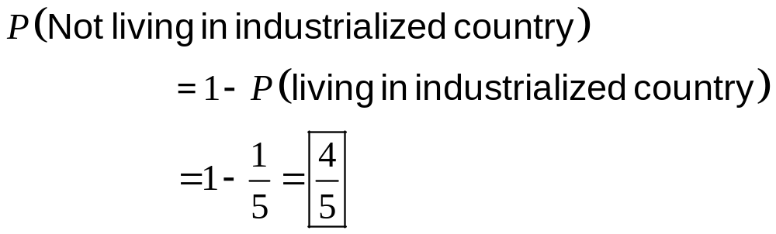
Example : Residence of People
If the probability that a person lives in an industrialized country of the world is , find the probability that a person does not live in an industrialized country.

Slide 19
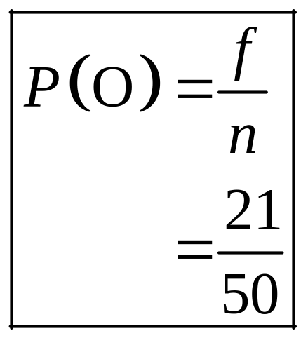
Example: Blood Types
In a sample of 50 people, 21 had type O blood, 22 had type A blood, 5 had type B blood, and 2 had type AB blood. Set up a frequency distribution and find the following probabilities.
  a. A person has type O blood.
Type | Frequency
A | 22
B | 5
AB | 2
O | 21
Total 50

Slide 20
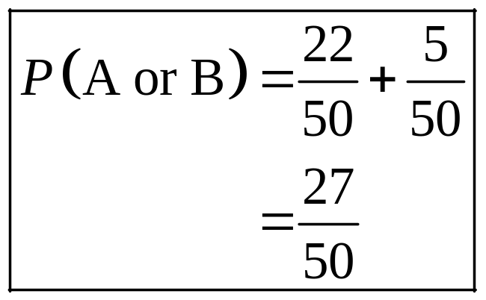
Example: Blood Types
In a sample of 50 people, 21 had type O blood, 22 had type A blood, 5 had type B blood, and 2 had type AB blood. Set up a frequency distribution and find the following probabilities.
  b. A person has type A or type B blood.
Type | Frequency
A | 22
B | 5
AB | 2
O | 21
Total 50

Slide 21
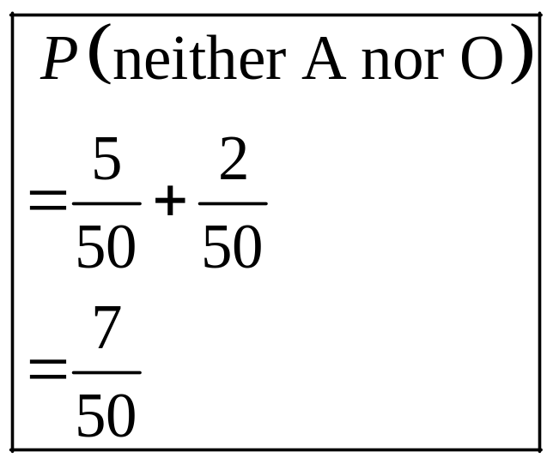
Example: Blood Types
In a sample of 50 people, 21 had type O blood, 22 had type A blood, 5 had type B blood, and 2 had type AB blood. Set up a frequency distribution and find the following probabilities.
  c. A person has neither type A nor type O blood.
Type | Frequency
A | 22
B | 5
AB | 2
O | 21
Total 50

Slide 22
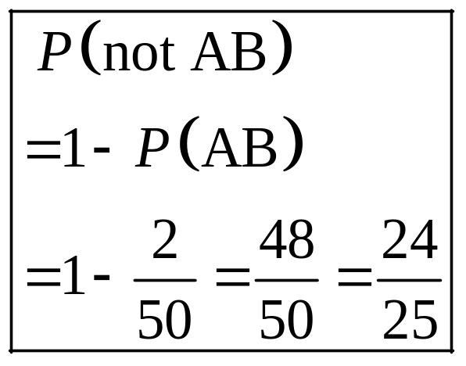
Example: Blood Types
In a sample of 50 people, 21 had type O blood, 22 had type A blood, 5 had type B blood, and 2 had type AB blood. Set up a frequency distribution and find the following probabilities.
  d. A person does not have type AB blood.
Type | Frequency
A | 22
B | 5
AB | 2
O | 21
Total 50

Slide 23
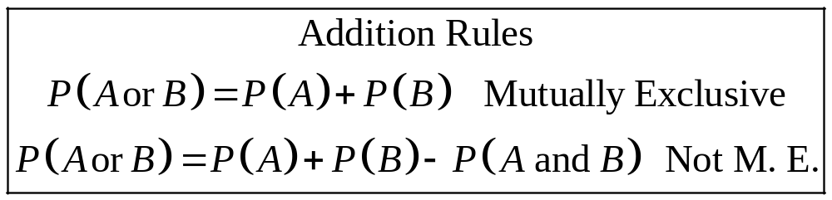
Addition Rules for Probability
Two events are mutually exclusive events if they cannot occur at the same time (i.e, they have no outcomes in common)

Slide 24
Example: Rolling a Die
Determine which events are mutually exclusive and which are not, when a single die is rolled.
  (a). Getting an odd number and getting an even number
  Getting an odd number: 1, 3, or 5
  Getting an even number: 2, 4, or 6
  Mutually Exclusive

Slide 25
Example : Rolling a Die
Determine which events are mutually exclusive and which are not, when a single die is rolled.
  (b). Getting a 3 and getting an odd number
  Getting a 3: 3
  Getting an odd number: 1, 3, or 5
  Not Mutually Exclusive

Slide 26
Example : Rolling a Die
Determine which events are mutually exclusive and which are not, when a single die is rolled.
  (c). Getting an odd number and getting a number less than 4
  Getting an odd number: 1, 3, or 5
  Getting a number less than 4: 1, 2, or 3
  Not Mutually Exclusive

Slide 27
Example: Rolling a Die
Determine which events are mutually exclusive and which are not, when a single die is rolled.
  (d). Getting a number greater than 4 and getting a number less than 4
  Getting a number greater than 4: 5 or 6
  Getting a number less than 4: 1, 2, or 3
  Mutually Exclusive

Slide 28
Example: R&D Employees
The corporate research and development centers for three local companies have the following number of employees:
U.S. Steel 110
Alcoa 750
Bayer Material Science 250
If a research employee is selected at random, find the probability that the employee is employed by U.S. Steel or Alcoa.

Slide 29
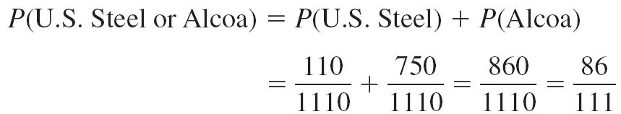
Example : R&D Employees

Slide 30
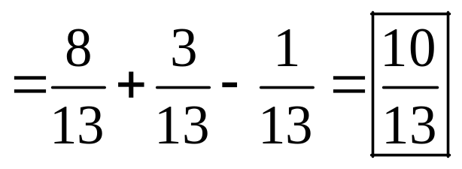
Example: Medical Staff
In a hospital unit there are 8 nurses and 5 physicians; 7 nurses and 3 physicians are females.
If a staff person is selected, find the probability that the subject is a nurse or a male.
Staff
Females
Males
Total
Nurses
7
1
8
Physicians
3
2
5
Total
10
3
13

Slide 31
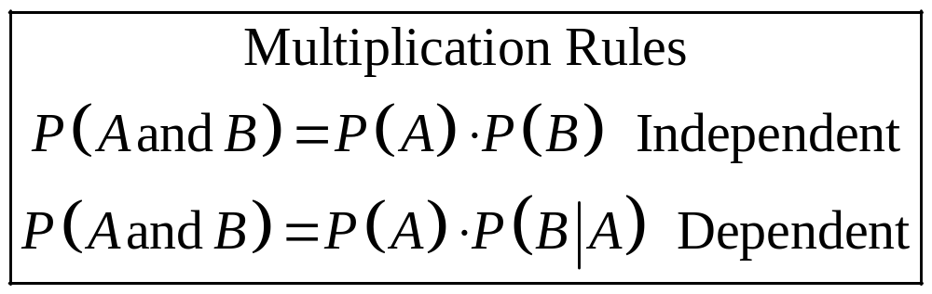
Multiplication Rules
Two events A and B are independent events if the fact that A occurs does not affect the probability of B occurring.

Slide 32
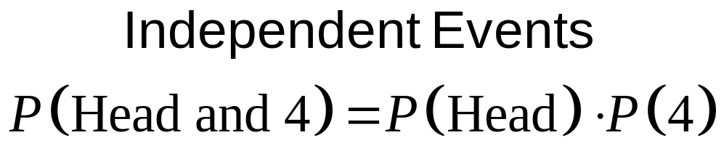
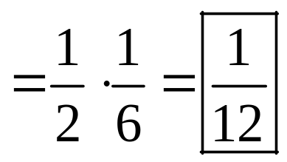
Example: Tossing a Coin
A coin is flipped and a die is rolled. Find the probability of getting a head on the coin and a 4 on the die.

Slide 33
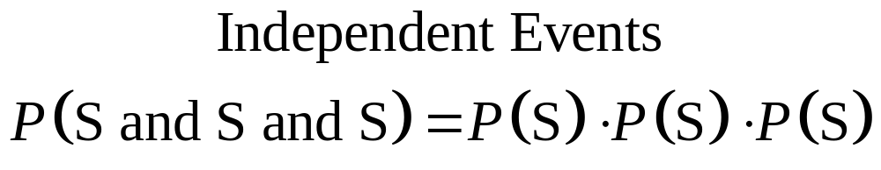
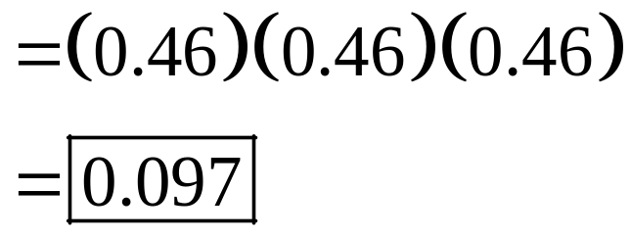
Example : Survey on Stress
A Harris poll found that 46% of Americans say they suffer great stress at least once a week. If three people are selected at random, find the probability that all three will say that they suffer great stress at least once a week.

Slide 34
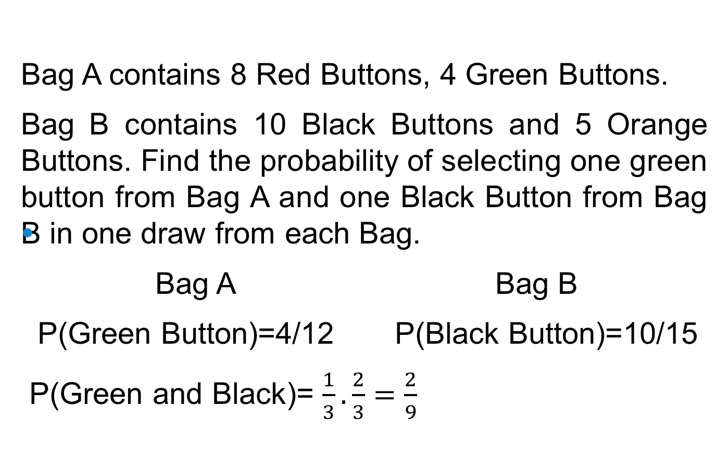
Buttons Example

Slide 35
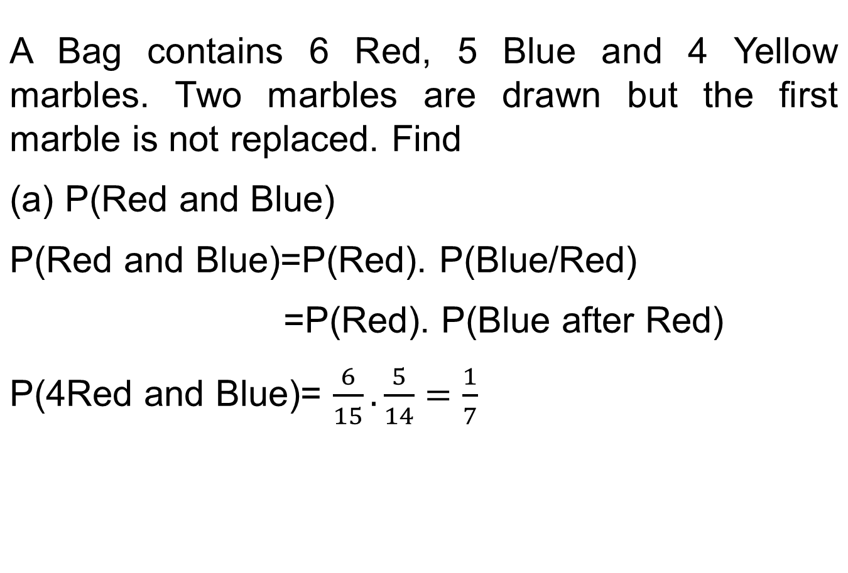
Marbles Example

Slide 36
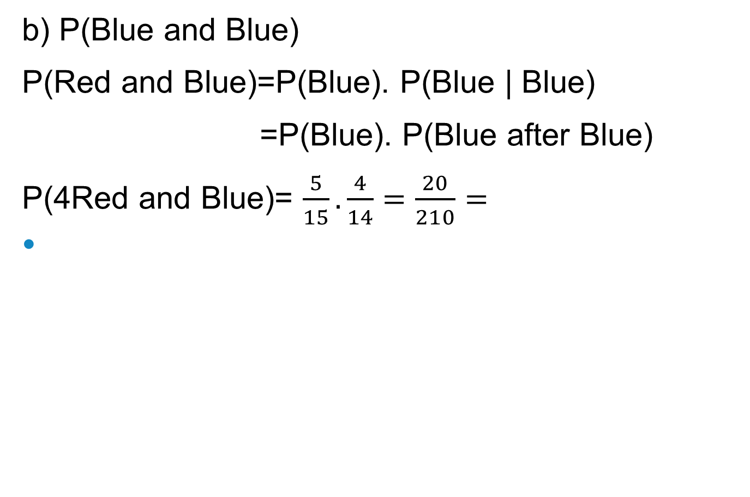
Marbles Example

Slide 37
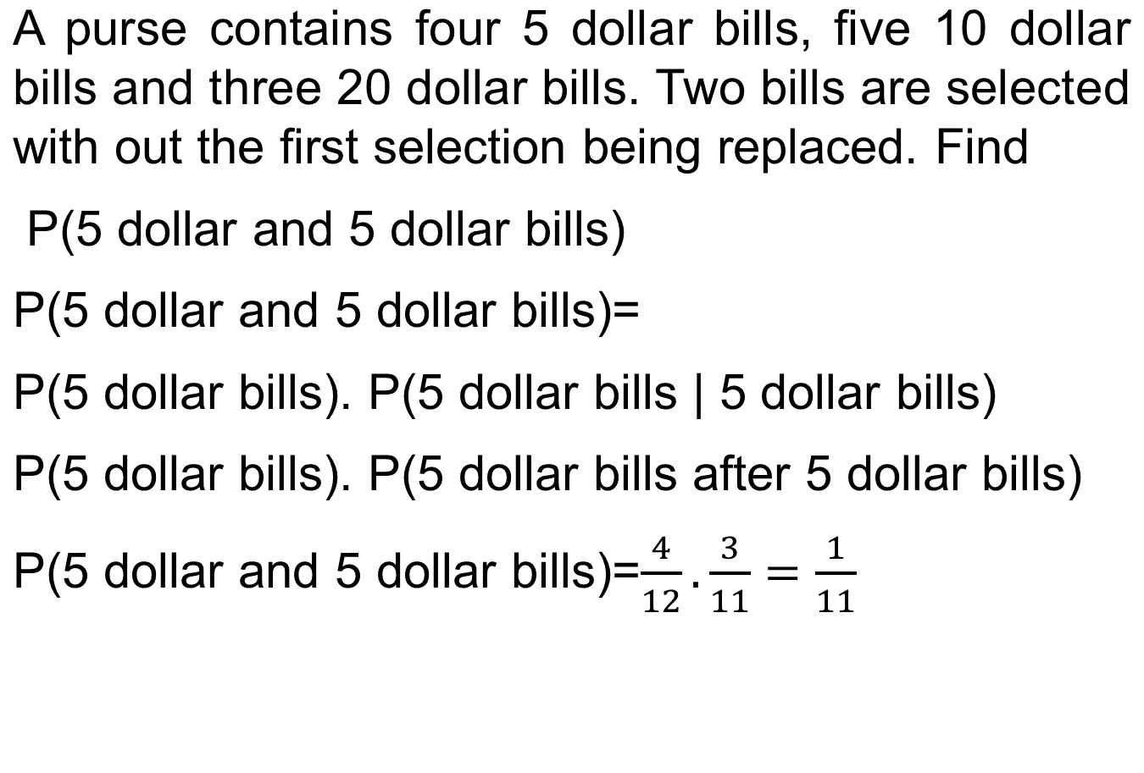
Bills Example

Slide 38
Cards Example
Two Cards are drawn from a well-shuffled ordinary deck of 52 cards. Find the probability that they are both aces if the first card is (i) replaced (ii) not replaced,
(i) In case of replacement, event A and B are independent.
P(both cards are aces)=P(A).P(B)=(4/52).(4/52)=1/169
(ii) If the first card is not replaced, then A and B are dependent events
P(both cards are aces)=P(first card is ace).P(second card is an ace given that the first card is an ace)
P(both cards are aces)=P(A).P(B | A)=(4/52).(3/51)
= 1/221

Slide 39
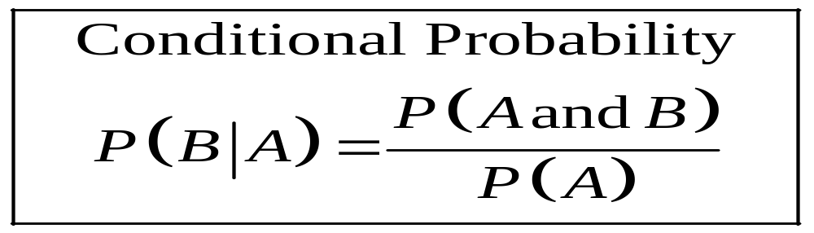
Conditional Probability
Conditional probability is the probability that the second event B occurs given that the first event A has occurred.

Slide 40
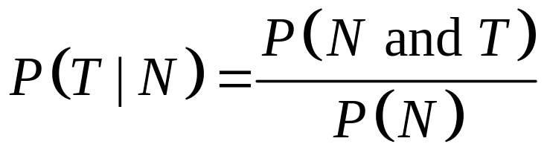
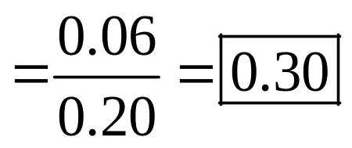
Example: Parking Tickets
The probability that Sam parks in a no-parking zone and gets a parking ticket is 0.06. The probability that Sam has to park in the no-parking zone is 0.20. On Tuesday, Sam arrives at school and has to park in a no-parking zone. Find the probability that he will get a parking ticket.
N = parking in a no-parking zone
T = getting a ticket

Slide 41
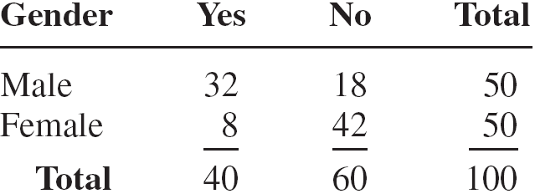
Example: Women in the Military
A recent survey asked 100 people if they thought women in the armed forces should be permitted to participate in combat. The results of the survey are shown.

Slide 42
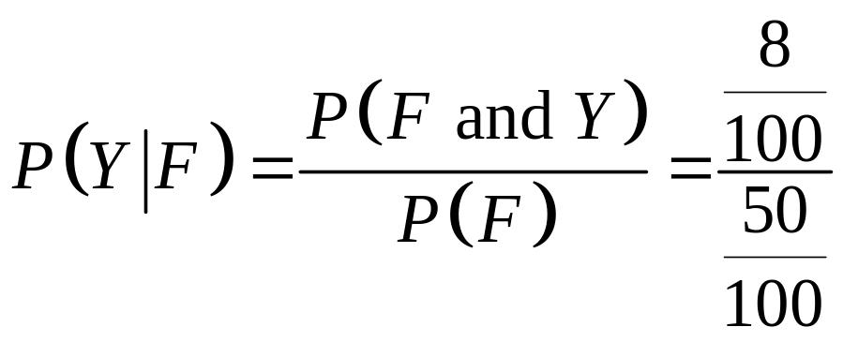
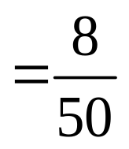
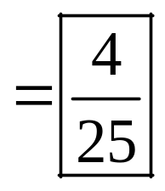
Find the probability that the respondent answered yes (Y), given that the respondent was a female (F).

Slide 43
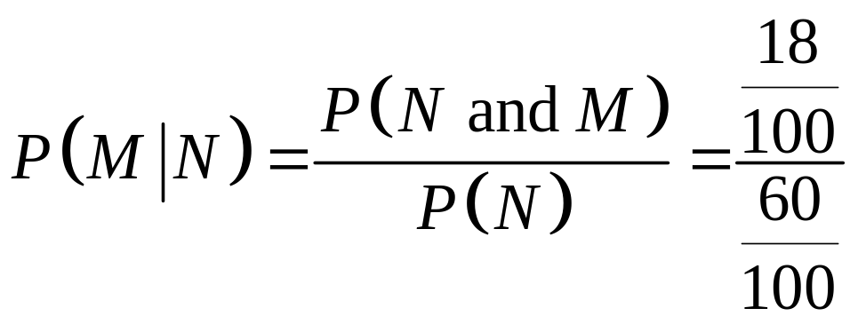
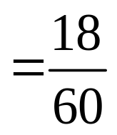
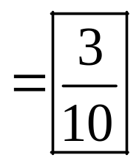
.
  (b). Find the probability that the respondent was a male (M), given that the respondent answered no (N).

Slide 44
Thank you

